Slide 1
Fuel Divider
Jacob Jossart
Kyle Rockwell
Kyle Jones
Jason Franks

Slide 2
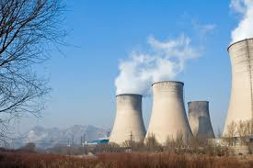
Problems with Fossil Fuels
Running out
Environmentally unfriendly
Causes conflict

Slide 3
Usage Per day

Slide 4
Running out
Only 157 years of fuel left
Used 6.8 billion gallons of oil last year
Predicted that we will use about 12 million barrels per day by 2015
Currently use about 9 million barrels per day
There are about 1,100 billion barrels left
Most oil is used for transportation

Slide 5
Environmentally Unfriendly
Largest greenhouse gas emitter in the world
Contributes to 75% of carbon, methane, many other greenhouse emissions.
The atmosphere already absorbs a ton of greenhouse gasses, and fossil fuel consumption adds 25% more harm to the atmosphere.
Pollution from gas causes an average of 1.8 million premature deaths each year.
Leads to asthma and lung diseases.

Slide 6
Causes Conflict
Fossil fuels are extremely valuable.
45% of fossil fuels on Earth are located in the Middle East
The rest of the world needs these resources
Conflict such as war arises

Slide 7
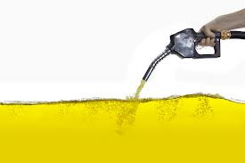
-Solution- Other Fuels
Other fuel sources are being created
Bio diesel and electric are the largest alternatives
Only 5% of people with cars use alternative fuels

Slide 8
Our Solution
When you create biodiesel the by product is glycerin
Our product separates these two substances for you, making the process more efficient
It is a rectangular metal compartment

Slide 9
How it Works
Pour bio diesel/glycerin solution into the compartment
Add butter
After stirring, the different substances will settle in layers based on density
Butter will settle in the middle of the glycerin and bio diesel
Open the latch on the bottom and the glycerin will pour out but the butter will stop the bio diesel from pouring out

Slide 10
Prototype
Along with the sketch up, we have made some bio diesel to show how it layers with the glycerin

Slide 11
Benefits
100% Environmentally friendly
Glycerin can be used in lotions and soaps
Cost less
Fun to make

Slide 12
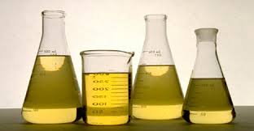
Cost/Materials
200ml of methanol: $3
Sodium hydroxide: $O.35
1 liter of vegetable oil: $3.75
Butter: $ 0.80
0.5 cubic meters of steel

Slide 13
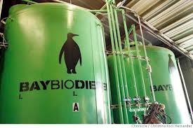
Support/Sponsors
Marin Bio fuels in San Rafael

Slide 14
Thank you

